Slide 1
Introduction to DBMS
Session 1
Taru Sharma, Shailendra Kumar Saini

Slide 2
Objective
Introduction
Types of Database
Relational Databases
Data Modeling
Entity Relationship Model
Normalization
MySQL
Connecting to MySQL

Slide 3
Introduction
Is a system software.
Is a collection of interrelated data (database).
Allows us to create and manage databases.
Provides users a systematic way to create, retrieve, update and manage data.
https://nptel.ac.in/courses/106105175/1
Notes:
Data -> Information ->Database
Link provided contains video lectures on DBMS from Prof. Partha Pratim Das of IIT Kharagpur

Slide 4
DBMS Types:
Flat File Based Database Management Systems
Hierarchical Database Management Systems
Network Database Management Systems
Object-oriented Database Management Systems
Relational Database Management Systems
Notes:
Evolution of database: https://medium.com/@rpolding/databases-evolution-and-change-29b8abe9df3e by Robert Polding Includes video links at bottom of above link, if one doesn’t want to read. Also available databases are: - Cloud database
NoSQL Database
Distributed Database
Centralised Database

Slide 5
Flat File Based Database
Stores data in a plain text file
Each line of the text holds a record
Fields of a record separated by a delimiter
Cannot contain multiple tables

Slide 6
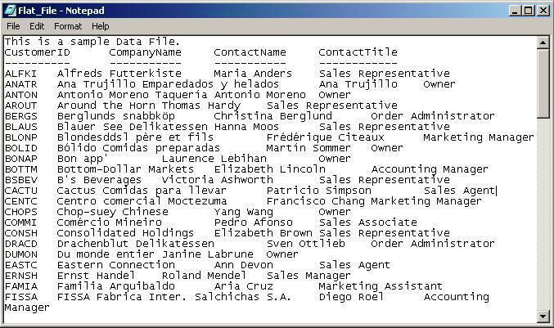
Flat File Based Database

Slide 7
Hierarchical Database
Operates in parent-child tree model
Each record can have one parent and multiple childs
Ideal for storing data with items that describe attributes and features
Records can be accessed and updated rapidly

Slide 8
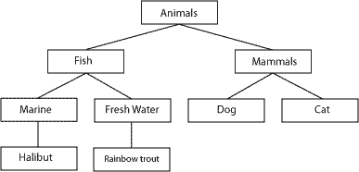
Hierarchical Database
Notes:
Similar to m-tree structure

Slide 9
Network Based Database
Is a progression from hierarchical model
Each child can have multiple parents
More flexible than hierarchical model
Allows many to many relationships

Slide 10
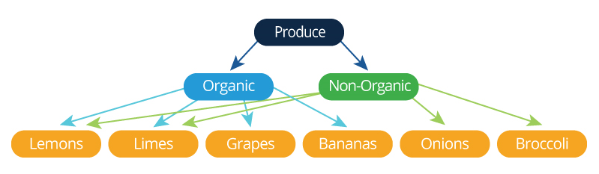
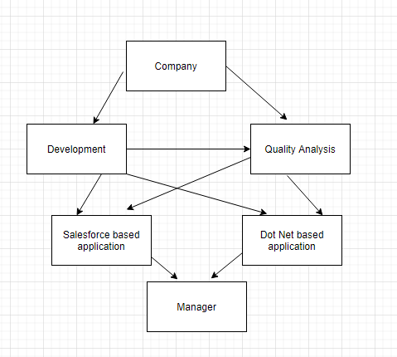
Network Based Database
Notes:
Similar to graphs

Slide 11
Object Oriented Database
Information is represented in form of objects
Database integrated with object-oriented programming language
Support for complex objects

Slide 12
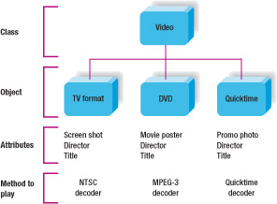
Object Oriented Database

Slide 13
Relational Databases
A relational database is a collection of data items organized as tables.
Table is comprised of columns and rows.
Columns define attributes of the data
A record is stored in a row. (tuple)

Slide 14
RDBMS Advantages
Can work with very large datasets.
Data redundancy can be minimized.
Easier to maintain security.
Easier to change and update data.
Flexible for future extensions.

Slide 15
Data Modeling
Process of creating a data model for an information system by applying certain formal techniques.
Conceptual representation of
Data Objects
Association between them
Rules
Notes:
High level model(Conceptual form)
Low level model (Logical form)
Representation model(physical form)

Slide 16
Conceptual Model
Defines What the system contains
Purpose is to establish the entities, their attributes, and their relationships
Entity: A real-world thing
Attribute: Characteristics or properties of an entity
Relationship: Dependency or association between two entities

Slide 17
Logical Model
Defines HOW the system should be implemented regardless of the DBMS
The process of creating a Logical model based on a conceptual model involves:
Setting the Attributes
Setting the Relationships

Slide 18
Physical Model
How data is physically represented on disk.
Involves adding “platform specific” detail to the model
Developed for a specific version of a DBMS, location, data storage or technology to be used in the project.
Primary and Foreign keys, views, indexes, access profiles, and authorizations, etc. are defined.

Slide 19
Advantages
Portrays a better understanding of business requirements
Creation of robust design and easy to rework
Improves performance
Improves data quality

Slide 20
Entity Relationship model
Defines conceptual view of database.
Is a way of graphically representing the logical relationship of entities.
Shows entities and relationship among them.
Notes:
For drawing of ER diagrams: https://app.diagrams.net/ or use Paint

Slide 21
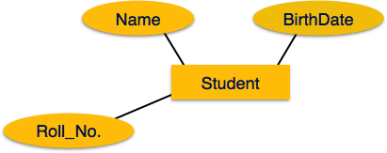
Entities & Attributes
Entity: (Table) (Rectangle)
is a real world object.
for example: in School database student, teacher, class can be considered as entities.
Attributes: (Column) (Ellipse)
Attributes are the properties of entities.
Attributes have values.
for example: Student entity can have attributes like: Name, Age, Roll Number.
Attributes can be of various types: Single, composite, multivalued, derived.

Slide 22
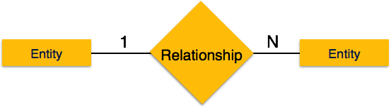
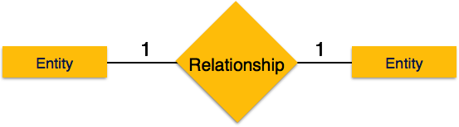
Relationship: (Diamond)
Is the association between entities.
For example: student enrolls in a course or employee works at a department.
Can also have attributes like entities.
Degree: Number of participant entries in a relationship.
Cardinality: Number of entities in one entity set can be associated with number of other entity set: One to One, One to Many, Many to One, Many to Many.

Slide 23
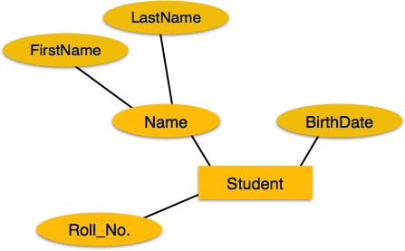
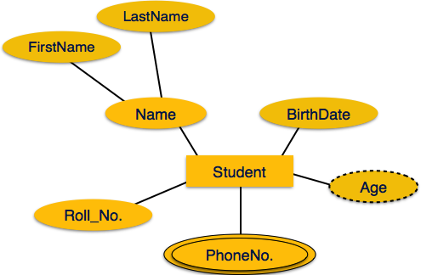
Representation: Entities and Attributes
Notes:
Key Attribute
Derived Attribute
Multi value Attribute

Slide 24
Table example
Table has 3 columns: Id, Name and Company.
Table has 4 rows, each representing set of data in terms of columns.
Id | Name | Company
1 | Chirag | Metacube
2 | Manish | Metacube
3 | Chris | ECI
4 | Jonathan | XYZ

Slide 25
Normalization
Database Normalisation is a technique of organizing the data in the database.
Normalization is a systematic approach of decomposing tables to eliminate data redundancy and undesirable characteristics like Insertion, Update and Deletion Anomalies.
Normalization is used for mainly two purpose:
Eliminating redundant data.
Ensuring data dependencies make sense i.e data is logically stored.
Normalization Rules:
1st Normal Form
2nd Normal Form
3rd Normal Form
BCNF
https://support.microsoft.com/en-us/kb/283878

Slide 26
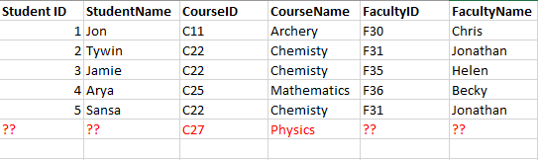
Normalization

Slide 27

MySQL
Is an open source database management software that helps users store, organize, and retrieve data.
Uses a standard form of the well-known SQL data language.
Works on many operating systems and with many languages including PHP, PERL, C, C++, JAVA, etc.
Is a very powerful program, supports large databases.

Slide 28

Connect to MySQL : Workbench
MySQL Workbench is a visual database design tool that integrates SQL development, administration, database design, creation and maintenance into a single, seamless environment for the MySQL database system.
MySQL Workbench delivers visual tools for creating, executing, and optimizing SQL queries. The SQL Editor provides color syntax highlighting, autocomplete, reuse of SQL snippets, and execution history of SQL.
https://dev.mysql.com/doc/workbench/en/wb-intro.html

Slide 29
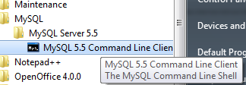
Connect to MySQL : Command Prompt
MySQL provides interactive shell for executing SQL commands. You can find MySQL client on MySQL installed machine. For example: MySQL 5.5 Command Line Client
It will ask for password, on providing correct password you will find mysql > prompt.

Slide 30

Connect to MySQL
Another way to connect is from command prompt: you can navigate to MySQL bin and type “mysql”.
Type: mysql -u <username> -p
It will ask for entering the password. Providing correct password will show mysql prompt

Slide 31
References
https://www.guru99.com/data-modelling-conceptual-logical.html
https://dev.mysql.com/downloads/workbench/
http://dev.mysql.com/doc/
http://www.mysqltutorial.org/
https://msdn.microsoft.com/en-us/library/aa266955(v=vs.60).aspx
https://nptel.ac.in/courses/106105175/1

